Slide 1
Designing your own APP
Lesson 3/4
Coming up with your idea

Slide 2

Unscramble this APP!

Slide 3
It was PET RESCUE SAGA

Slide 4
WALT and WILF
WALT – Design our own APP with an audience and purpose in mind
WILF – A completed design with several screens, audience and purpose should be indicated

Slide 5
What will be the category of your APP?
Your APP must fall into one of the categories we have below:
Entertainment
Education
Sport
Shopping
Information

Slide 6
What will be the APP’s purpose?
Will your APP:
Entertain people about something
Inform (tell) people about something
Educate people about something
You must have a purpose – the stronger the purpose the better the APP!

Slide 7
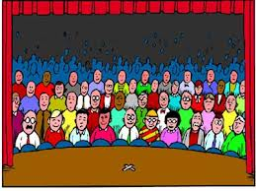
Who is your audience?
Your audience must cover the following three areas:
Gender (Male/Female)
Age (Children/Teenagers/Adults etc.)
Interests (Sports/Shopping etc.)
Your APP needs to have these clearly identified before you continue.

Slide 8
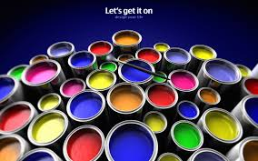
Complete the DESIGN YOUR APP worksheet!
Complete the DESIGN YOUR APP sheet!
You will need to design an MENU screen and ICON along with 2 other pages.
Remember what you can and cant do in APPShed!
Sheet needed – Design your APP

Slide 9
Collecting images for your APP
Once you have finished your design you can start to collect images from the Internet that match your APP idea.
You will want images for:
Icon (simple image – can be designed yourself)
Background (keep it plain so you can read text over the top)
Any other purpose (i.e. gallery)
SAVE the IMAGES to a NEW FOLDER for your mobile app!

Slide 10
Reviewing our progress
If you have finished your design go to the left side of the room
If you still have more to do go to the right side of the room
(First lesson of planning – most people will be unfinished… however, if it is unfinished next lesson you will have homework)

